Slide 1
ML Model Registry – what?
Pravin Y Pawar
Adapted from ML Model Registry
By Stephen Oladele

Slide 2
Questions from cross-functional team
Where can we find the best version of this model so we can audit, test, deploy, or reuse it?
How was this model trained?
How can we track the docs for each model to make sure they are compliant and people can know the necessary details about it including the metadata?
How can we review models before they are put to use or even after they have been deployed?
How can we integrate with tools and services that make shipping new projects easier?
They want to understand
what is running in production,
how to improve it
or roll back to previous versions
It makes perfect sense!

Slide 3
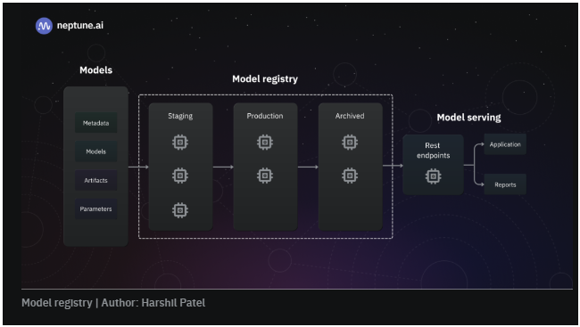
What is a model registry?
An ML model registry serves as a
centralized repository, enabling effective
model management and documentation
Allows for
clear naming conventions,
comprehensive metadata,
and improved collaboration between data scientists and operations teams,
ensuring smooth deployment and utilization of trained models
A data scientist can push trained models to the model registry
Once in the registry, models are ready to be tested, validated, and deployed to production

Slide 4
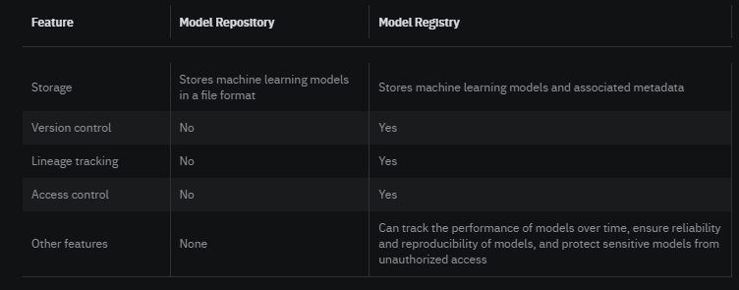
Model registry vs model repository
Model Repository is a storage location for machine learning models
Model Registry is a more comprehensive system that tracks and manages the full lifecycle of machine learning models.
However, both are often used interchangeably, and the specific definitions may vary depending on the context or the tools and platforms being used.

Slide 5
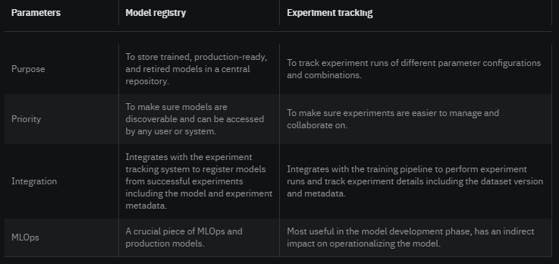
Model registry vs Experiment tracking
Model registry has to integrate
with the Experiment
management system (which
tracks the experiments) to
register models from various
experiment runs to make them
easier to find and work with.

Slide 6
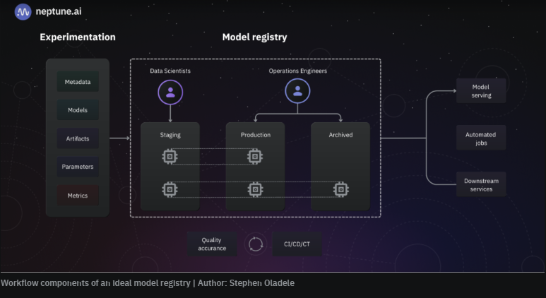
Model registry key components

Slide 7
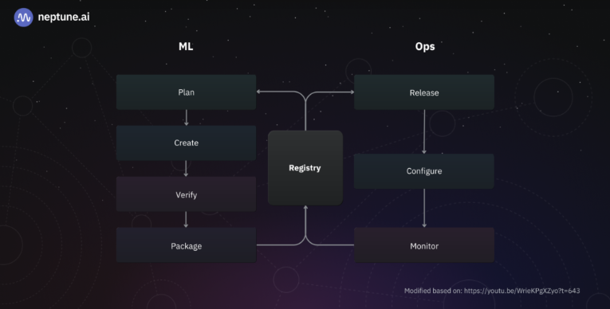
Model registry key features and functionalities
Acts as a centralized storage for effective collaboration
Model registry provides a central storage unit that holds models (including model artifacts) for easy retrieval by an application (or service)
Without the model registry, the model artifacts would be stored in files that are difficult to track and saved to whatever source code repository is established
The centralized storage also enables data teams to have a single view of the status of all models, making collaboration easier
Bridges the gap between experiment and production activities
Model registry acts as a glue between ML experimentation and Operations,
enabling model development, software development, and operational teams to collaborate.

Slide 8
Model registry key features and functionalities(2)
Providing a central UI
Model registry provides teams with visibility over their models
With a central interface, teams can:
Search for models,
View the status of models (if they are being staged, deployed, or retired),
Approve or disapprove models across different stages,
And view the necessary documentation.
This makes model discovery easier for everyone on the team.
If a model needs to be deployed, the operations teams can easily:
Search for it,
Look up the validation results and other metrics,
Package the model (if needed),
And move it from the staging environment to the production environment.
This improves the way cross-functional teams collaborate on ML projects.

Slide 9
Model registry key features and functionalities(3)
Enables model versioning by tracking different versions of a model
Model registry enables model versioning by tracking the different versions of a model as they are
developed and improved
This allows to compare different versions of the model, track its performance, and select the best version
for deployment
Here’s how it typically works:
Model Registration: When a new model is developed or trained, it is registered in the model registry.
Version Control: The model registry maintains a history of all registered models and their versions.
Model Comparison: The model registry allows users to compare performance metrics, model architectures,
hyperparameters, and other relevant information in different versions of a model.
Model Tracking: As new versions of the model are developed or trained, they are registered in the model registry as
well, incrementing the version number.
Retention and Archiving: The model registry typically retains older versions of the models, ensuring a complete
history and traceability.
By enabling model versioning, the model registry ensures that different iterations of a model can be stored, tracked,
compared, and accessed conveniently.

Slide 10
Model registry key features and functionalities(4)
Integrates with experiment management systems or training pipelines
Model registry integrates with systems that output the trained model
The trained models could be the raw artifacts (model weights, configuration, and metadata) or models that have been serialized into a file
(e.g., an ONNX file) for compatibility with the production environment or containerized (using Docker) to be exported to the production
environment.
Model registries:
Register the model,
Assign a version to it,
Note the version of the dataset the model was trained on,
Add annotations and tags,
Retrieve the parameters, validation results (including metrics and visualizations), and other relevant model metadata on the model from the experiment
management system.
To make collaboration easier, the registry also includes details such as:
The model owner or developer,
Experiment run id the model was trained under,
Versioned model source code,
Environment runtime dependencies used to train the model (and the versions),
Comments and model change history,
And the model documentation.

Slide 11
Model registry key features and functionalities(5)
Integrates with the staging environment for trained models
Model Registry provides the functionality for integrating with the staging environment for running all types of checks and balances on the model
can include integration testing (with other applications) and other QA tests before the model can be
promoted to the production environment
In the staging environment, the model reviewers should also be able to perform fairness checks on the model to ensure it:
Outputs explainable results,
Complies with regulatory requirements,
And provides useful business benefits.

Slide 12
Model registry key features and functionalities(6)
Integrate with model delivery (CI/CD) tools and services for automation
Automation is a critical part of building any scalable software
In machine learning, building automated pipelines will allow to spend more time building new products rather
than maintaining old models
A Model registry integrates with pipeline automation tools and provides custom APIs that can allow to plug into custom workflow tools
For example, using webhooks to trigger downstream actions based on predefined events in the registry.
Should also be able to configure model promotion schemes through different environments like
development (training), staging (testing), and production (serving)
Performance is a crucial requirement for building automated pipelines
Model registries should be highly available for automated jobs that are event or schedule-based to enable continuous training and delivery of the model

Slide 13
Model registry key features and functionalities(7)
Provides an interface for downstream systems to consume models
Model registries provide interfaces that enable downstream services to consume the model through API integration
The integration can also track offline and online evaluation metrics for the models
makes it easy to build an automated setup with CI/CD/CT with ML pipelines
downstream service could be either a model user, an automated job, or a REST serving that can consume the most stable—or any—version of the model
Integrate with model deployment tools
Eventually, models have to be deployed, and the more efficient the deployment process, the better.
Model Registries:
Integrate with downstream services and REST serving services that can consume the model and serve it in the production environment.
Collect real-time (or aggregated) metrics on the production model to log performance details of the model. This will be helpful for comparison between models (deployed and staged), as well as auditing the production model for review

Slide 14
Thank You!
In our next session:

